Slide 1

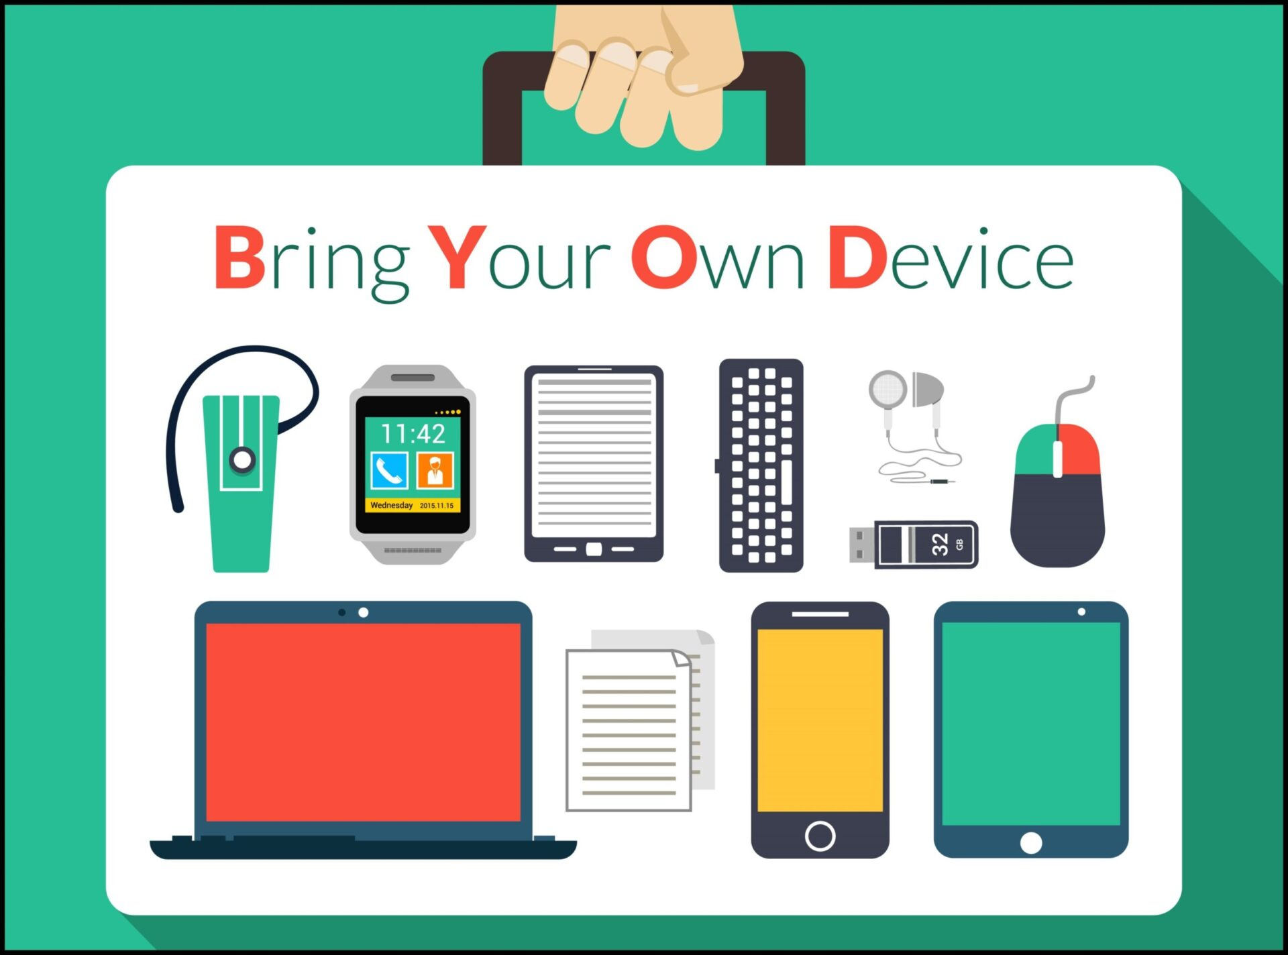
BYOD Can Work
Anthony Zatika
Notes:
Hello, welcome to my presentation on how a BYOD network can work when paired with MDM (Mobile Device Management) platforms.

Slide 2
Agenda
What is MDM
Recap on iPhones
Android Devices
Prospects of MDM with Android and Apple
Questions/Concerns
Next Week
Notes:
For the agenda today, I will be explaining MDM, recapping on iPhone security, looking into Android security, and explaining the prospects of Android and iPhone security through MDM. I will finally conclude with my questions and concerns and my ideas for next week’s presentation.

Slide 3
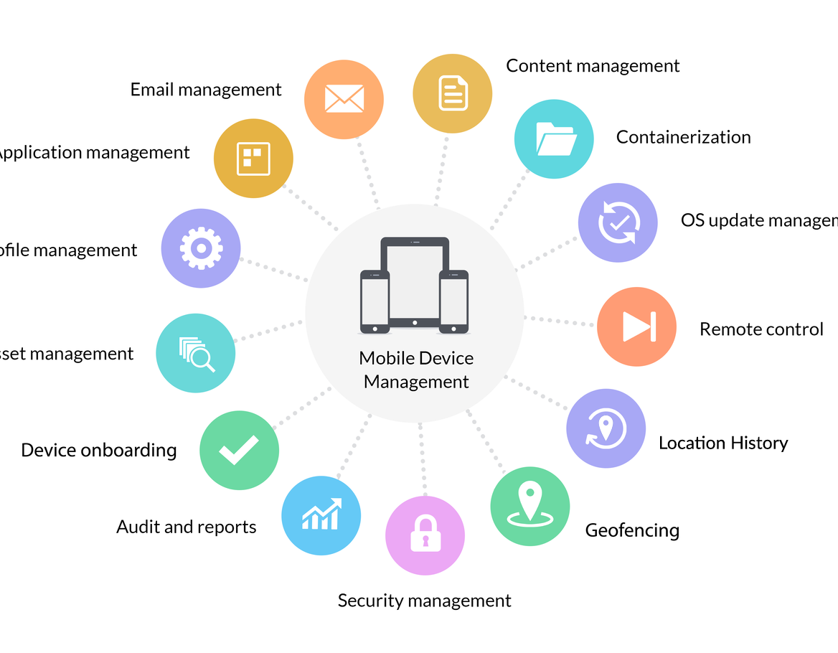
What is mdm
MDM is a software to provision mobile devices
MDM applies software, processes and security policies onto mobile devices
MDM solutions protect the device’s applications, data and content
MDM is a device-centric approach
MDM software can monitor behaviors and business-critical data on enrolled devices
Notes:
Ok, so, what is MDM. MDM is called Mobile Device Management and IBM has extensively labeled material on MDM. First, MDM is a software that is used to provision mobile devices. MDM is a suite that can control devices by applying software processes and security processes. MDM solutions are specifically designed to protect device’s applications pertaining to data and content, in other words CUI. One important fact to note is that MDM is a device-centric approach which means it focuses on managing the security and integrity of a user's device rather than changing the behavior of the user. Therefore, MDM is extraordinary useful because the software suite can monitor business critical data on the enrolled devices.

Slide 4
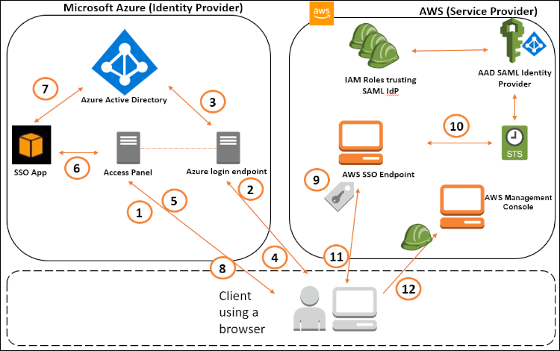
MDM is split into 5 parts
Device tracking
Mobile management
Application security
Identity and access management (IAM)
Endpoint security
Unified endpoint management
Notes:
There are five areas of MDM according to IBM. There is the device tracking area which will keep track of where a user's phone travels, “Each device enrolled with or issued by an enterprise can be configured to include GPS tracking and other programs” (IBM, n.d). This is to ensure that if a device is stolen, it can easily be tracked to who stole it. Then, there is the mobile management area where an IT department can deploy and manage mobile devices. There is the Application Security area where security controls can actually wrap apps, meaning that IT security admins can apply security features to any app that they would like. There is also the Identity and access management area which allows users to identify themselves. For instance, a user can access an organization through single sign-on, or multifactor authentication. Last, but not least, there is the Endpoint Security (Unified endpoint management) area where devices such as IoT, wearables, sensors, and any device can be directly connected to a secure network that protects all devices. IBM explains that this area uses, “an agile UEM system, [where] enterprises can choose scalable solutions based on needs, whether those enterprise are covering a single operating system or various devices across different platforms, such as Apple iOS iPhone, Android, Microsoft Windows, macOS and Chrome OS” (IBM, n.d).

Slide 5
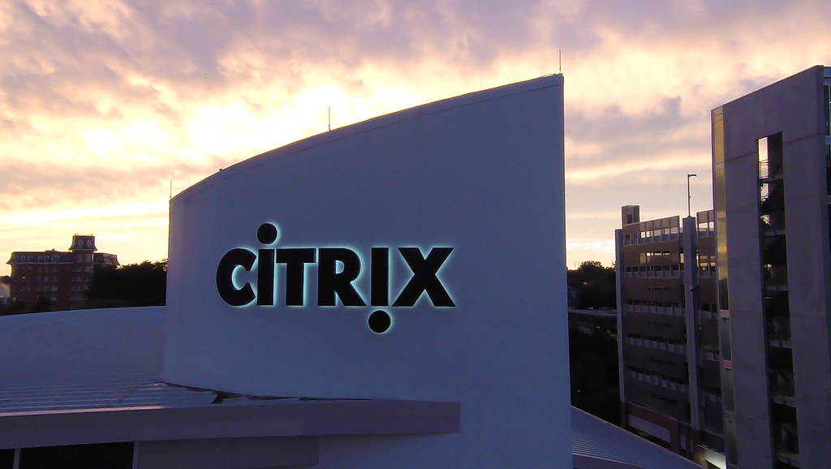
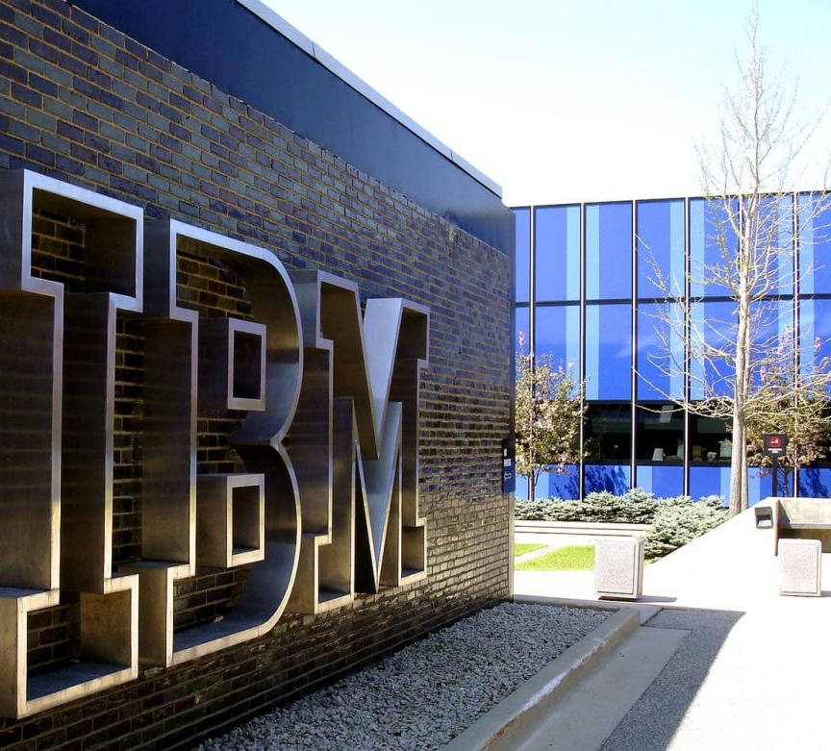

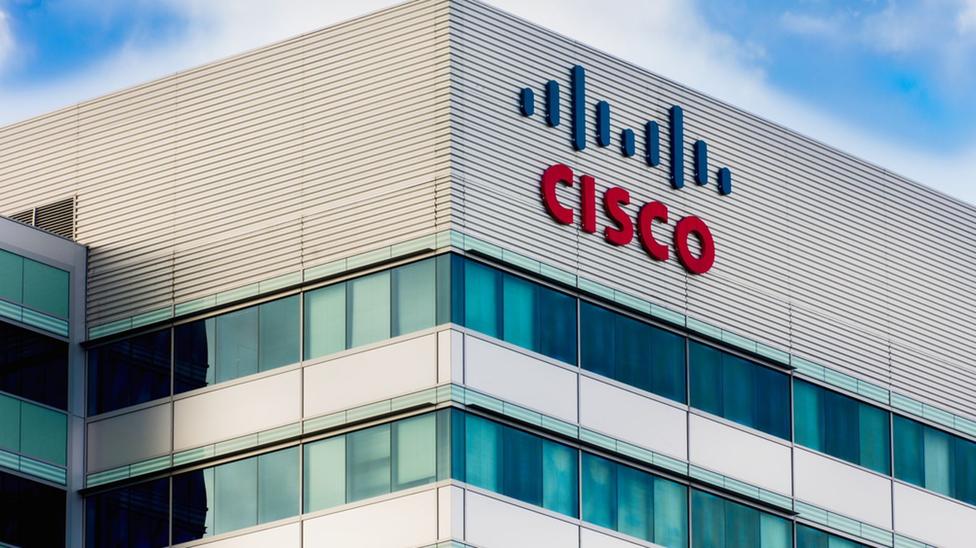
MDM service providers
Cisco Meraki
Citrix Systems
IBM
Amazon Web Services
Notes:
As the text on the slide illustrates, there are numerous MDM service providers. Although this is not any where near close to all the MDM providers, these are some of the most notable. Using these MDM service providers, you can be assured that your mobile devices will be secure in a BYOD network. Many companies believe that BYOD are extremely dangerous to their networks. This is only the case if either the devices or the network in which the device sits is not protected. Therefore, the companies listed above can integrate with an already established network security policy or create its own. According to an article written by American Express, Adam Levin who is a former director of the New Jersey Devision of Consumer Affairs on Forbs wrote, “‘From my perspective, the short-term capital savings from BYOD is easily outweighed by the expense and reputational damage to an organization that’s possible when an employee clicks on malware, a phishing scam or other compromising media’” (American Express, 2014). This article was written in 2014 so think of all the new advancements of security we have had through the years. The bottom line is that a BYOD network is just as secure as any conventional network with desktop workstations.

Slide 6
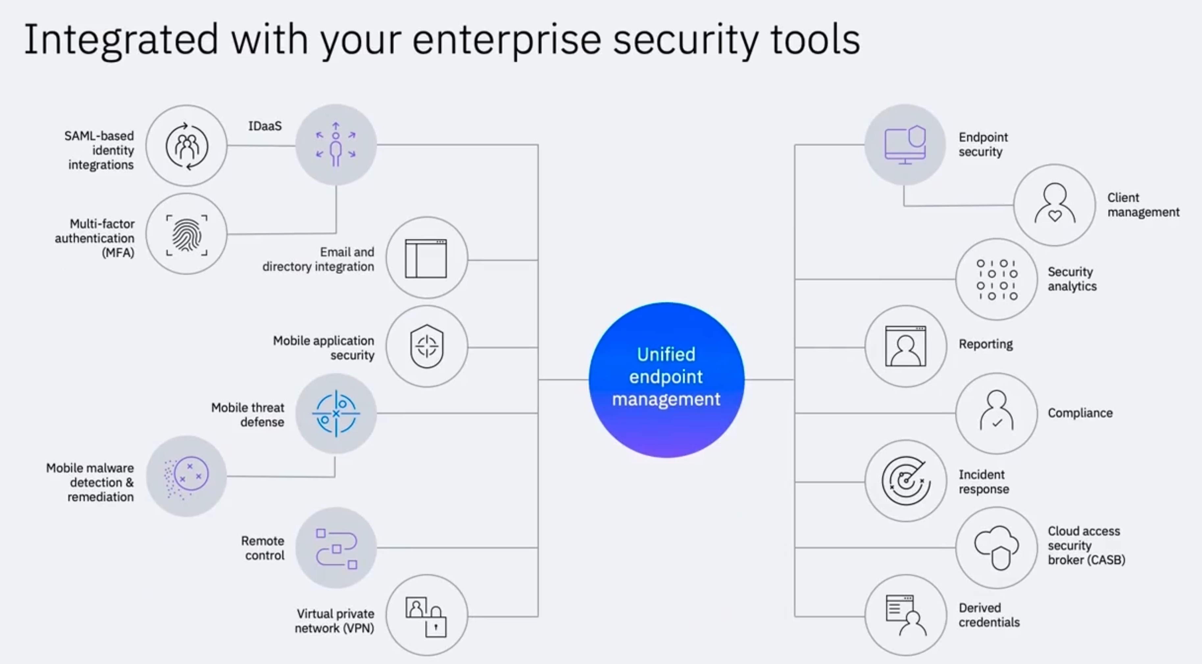
Physical Security
iPhone
Android
Mac
Windows
Notes:
However, an important fact to note is that although MDM service providers have cutting edge technology to protect mobile BYOD networks, the physical security of the device is a make-or-break idea. For instance, if a mobile device was not created with security in mind, it will be gravely vulnerable no matter what technology IBM or other MDM providers have. The reasoning for this is because IBM’s MDM suite can not modify the underlying security of a mobile device's hardware (processor, ram, speakers) or base code of the OS. MDM can only protect through identification, malware detection, VPN’s and other areas as listed in the picture above of IBM’s MDM solutions.

Slide 7
Apple, android security
iPhone security is supreme.
4 areas of security, Hardware, Software, Operating System, and Services
Android security is good, not supreme.
Android is open source
Designed for users and developers
Hardware security
Operating System Security
Runtime Security
Notes:
We already know that iPhone security is supreme. As explained in my last presentation, the iPhone was built with 4 areas of security, Hardware, Software, Operating System, and Service security. In contrast, Android was built with security in mind as well, but also as a haven for android developer. Android is open source meaning that threat nation states such as China, Iran, Russia can openly look through the code. According to a publication from Norton (Norton Antivirus), “Apple’s iOS operating system has long been considered the more secure of the two operating systems. iOS is a closed system. Apple doesn’t release its source code to app developers, and the owners of iPhones and iPads can't easily modify the code on their phones themselves. [On the other hand,] Android devices are the opposite, relying on an open-source code, meaning that the owners of these devices can tinker with the operating system of their phones and tablets. Too much tinkering, and owners might create a weakness in their devices’ security. Then there are manufacturers themselves. If a phone maker puts out a new device with a modification to the Android operating system and there’s a vulnerability in that code, hackers will find it” (Norton, 2022). This is, of course, terrible for a BYOD network where users can modify their devices at will. It seems that if a BYOD workplace has Android devices on the network, it is a titanic security liability, companies better have renewed their cybersecurity insurance!

Slide 8

Android liability
Android’s open-source code is not as big of a deal as it appears
All basic security measure are there
Hardware Security
App Security
Operating System Security
Runtime Security
Notes:
Although Android devices are open source, this is not as big of a deal as it appears. Android still has incorporated the basic security measures to stack up against the iPhone. The Android does include Hardware Security, App Security, Operating System Security, and Runtime Security which is the same as the iPhone. Although I wouldn’t recommend ever buying or using an Android device for a BYOD network (I am partial to Apple), I have discovered that IBM’s MDM solutions do integrate with Android. As long as threat nation states do not discover a deep vulnerability such as a Zero day attacks for Android devices (which can happen to any device) Android devices in a workplace should be fine.

Slide 9

Sum up
iPhone still is the best for security
Android is just ok for security
MDM can integrate with all devices including IoT
MDM will make BYOD networks safe
Notes:
To sum up, Apple devices are still the best for security. Each aspect of the hardware, software, services, and operating system is chocked full of security controls. Although Android is ok for security, I am just bothered by the open-source nature of the platform. However, MDM can integrate with all devices even IoT and can implement a suite of tools and applications to make BYOD network safe.

Slide 10

Questions/concerns
Open Source
More Developers
Easier to Modify
Notes:
Again, just to really hit home the point about security, I have my questions and concerns. Besides finding vulnerabilities in Androids source code, what other implications does open source have on Android Devices? I’ll give a hint, there are certainly more developers that use Android, so malicious developers can create apps as well. Last, but not least, Androids are easier to modify, so what’s to stop someone from disabling core security features? In my honest opinion, it does not appear to be a good idea to let Android devices into the workplace. However, since this is a BYOD network, this policy would defeat the purpose of what BYOD stands for. Through my research, Android devices created a murky water type situation that I couldn’t ignore and really creates a problem for a BYOD network.

Slide 11
Next Week
Focus on Penetration Testing
Show how MDM stops local threats
Man in The Middle Attack Demonstration
OWASP ZAP vuln testing
Notes:
This concludes my presentation. For next week, I was thinking that I can focus on some penetration testing. I wanted to create a power point demonstration on local threats. Perhaps I can get a demonstration of MDM fending off MITM attacks or OWASP ZAP scans?

Slide 12
References
Campbell, S. F. (2015, February 3). Image from https://c2.staticflickr.com/4/3206/3030416930_d7555dcd9e.jpg. Flickr. Retrieved June 19, 2022, from https://www.flickr.com/photos/samuelfcampbell2003/16432765042
Droidviews. DroidViews. (2022, June 18). Retrieved June 19, 2022, from https://www.droidviews.com/
Invest in Holland helps foreign business set up in the Netherlands. NFIA. (2022, March 30). Retrieved June 19, 2022, from https://investinholland.com/
Is Byod a dangerous policy for small businesses? Business Class: Trends and Insights | American Express. (n.d.). Retrieved June 19, 2022, from https://www.americanexpress.com/en-us/business/trends-and-insights/articles/is-byod-a-dangerous-policy-for-small-businesses/
ManageEngine. (n.d.). Features. ManageEngine Endpoint Central features | Unified Endpoint Management Software. Retrieved June 19, 2022, from https://www.manageengine.com/products/desktop-central/features.html
Understand the news. Vox. (n.d.). Retrieved June 19, 2022, from https://www.vox.com/
What is Mobile Device Management (MDM)? IBM. (n.d.). Retrieved June 19, 2022, from https://www.ibm.com/topics/mobile-device-management

